Slide 1

DES EnCIPHER And decipher Core Specification

Slide 2
I. High level Block

Slide 3
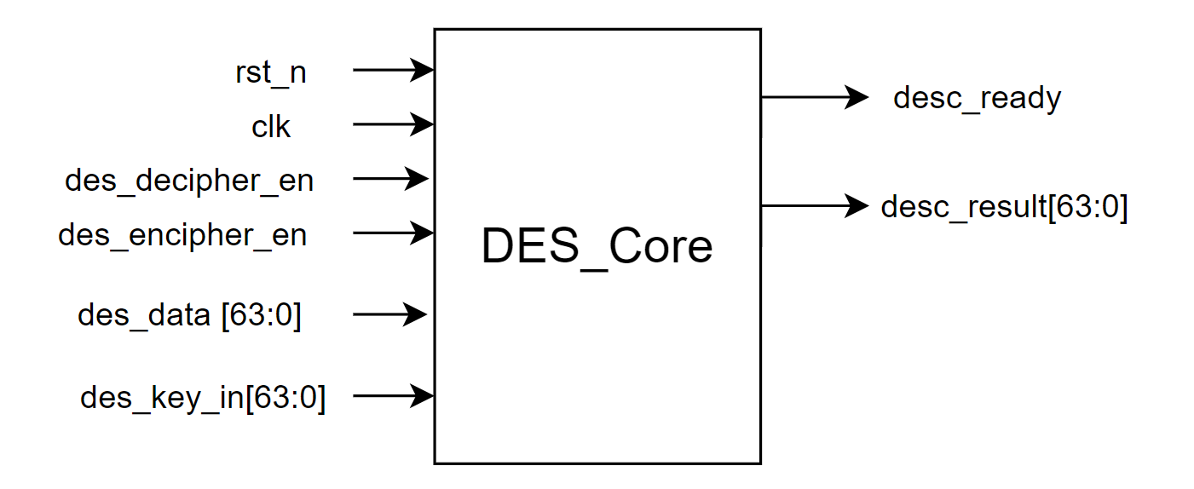
Signal Diagram

Slide 4
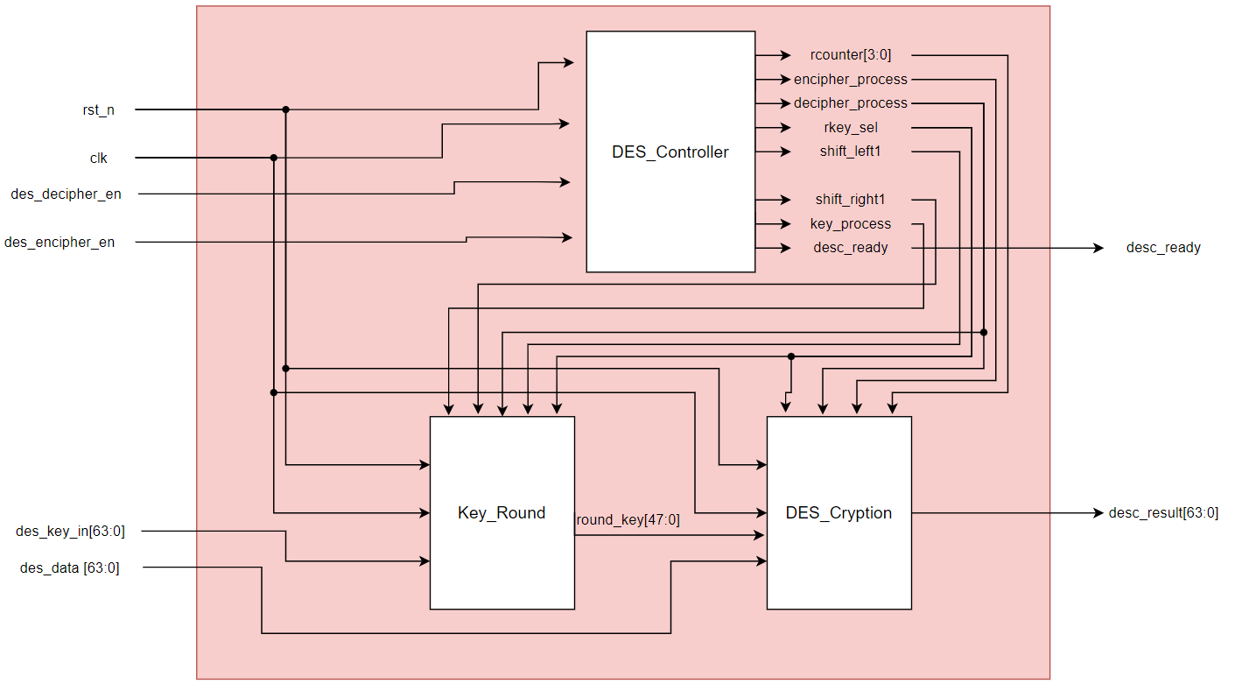
Port | Size | Direction | Description
clk | 1 | input | Clock
rst_n | 1 | input | Asynchronous reset, active low
des_encipher_en | 1 | input | Encryption start signal, active for 1 cycle of the system clock
des_decipher_en | 1 | input | Decryption start signal, active for 1 cycle of the system clock
des_data | 64 | input | Data needs encryption/ decryption
des_key_in | 64 | input | Key using for encryption/ decryption process
desc_ready | 1 | output | Signal indicating that the DES core is idle or has completed an encryption/ decryption process
desc_cresult | 64 | output | Data has been encryption/ decryption

Slide 5
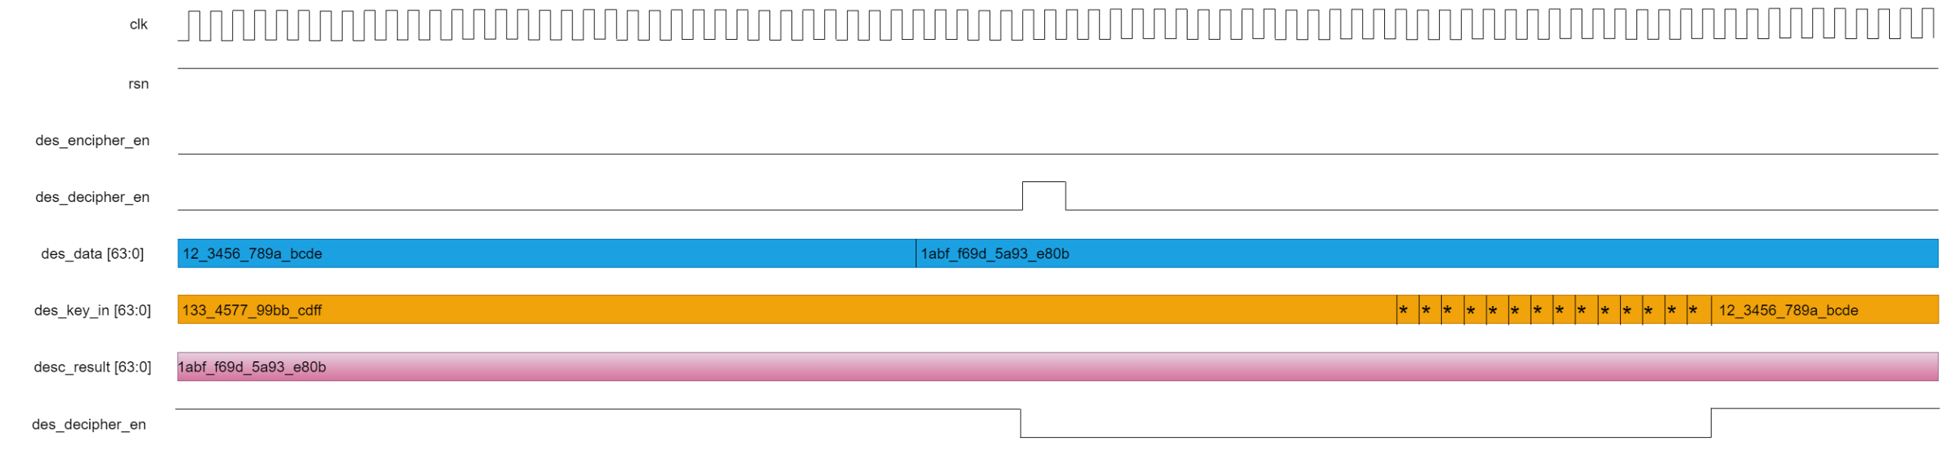
Waveform

Slide 6
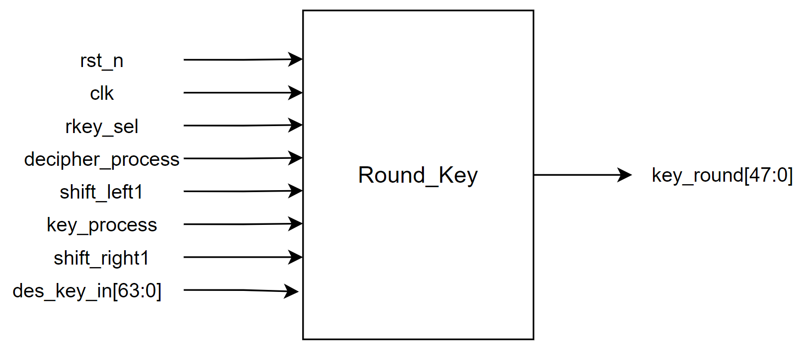
1. DES Round Key Block (Round Key Generation Circuit)
This block is responsible for generating 16 round keys from the main keyunds.

Slide 7
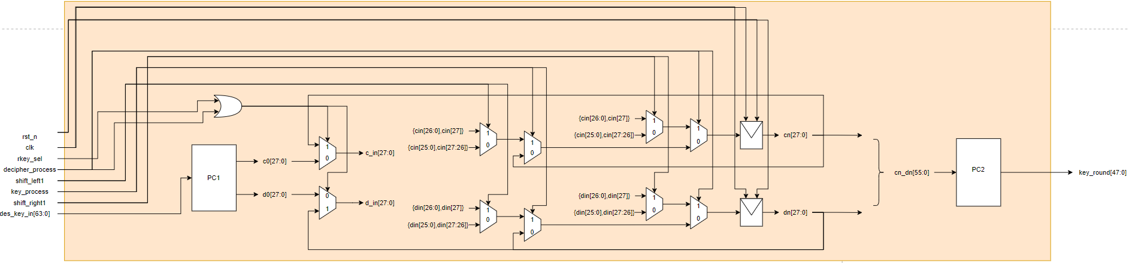
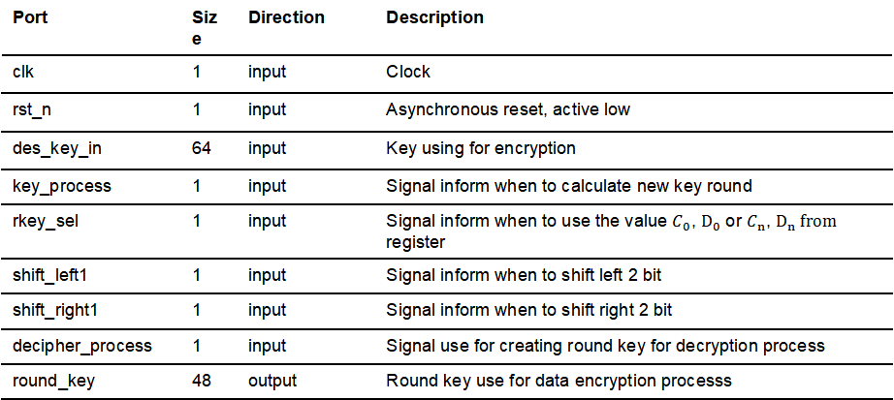
Port | Size | Direction | Description
clk | 1 | input | Clock
rst_n | 1 | input | Asynchronous reset, active low
des_key_in | 64 | input | Key using for encryption
key_process | 1 | input | Signal inform when to calculate new key round
rkey_sel | 1 | input | Signal inform when to use the value $C_{0}$, $D_{0}$ or $C_{n}$, $D_{n} from$ register
shift_left1 | 1 | input | Signal inform when to shift left 2 bit
shift_right1 | 1 | input | Signal inform when to shift right 2 bit
decipher_process | 1 | input | Signal use for creating round key for decryption process
round_key | 48 | output | Round key use for data encryption processs

Slide 8
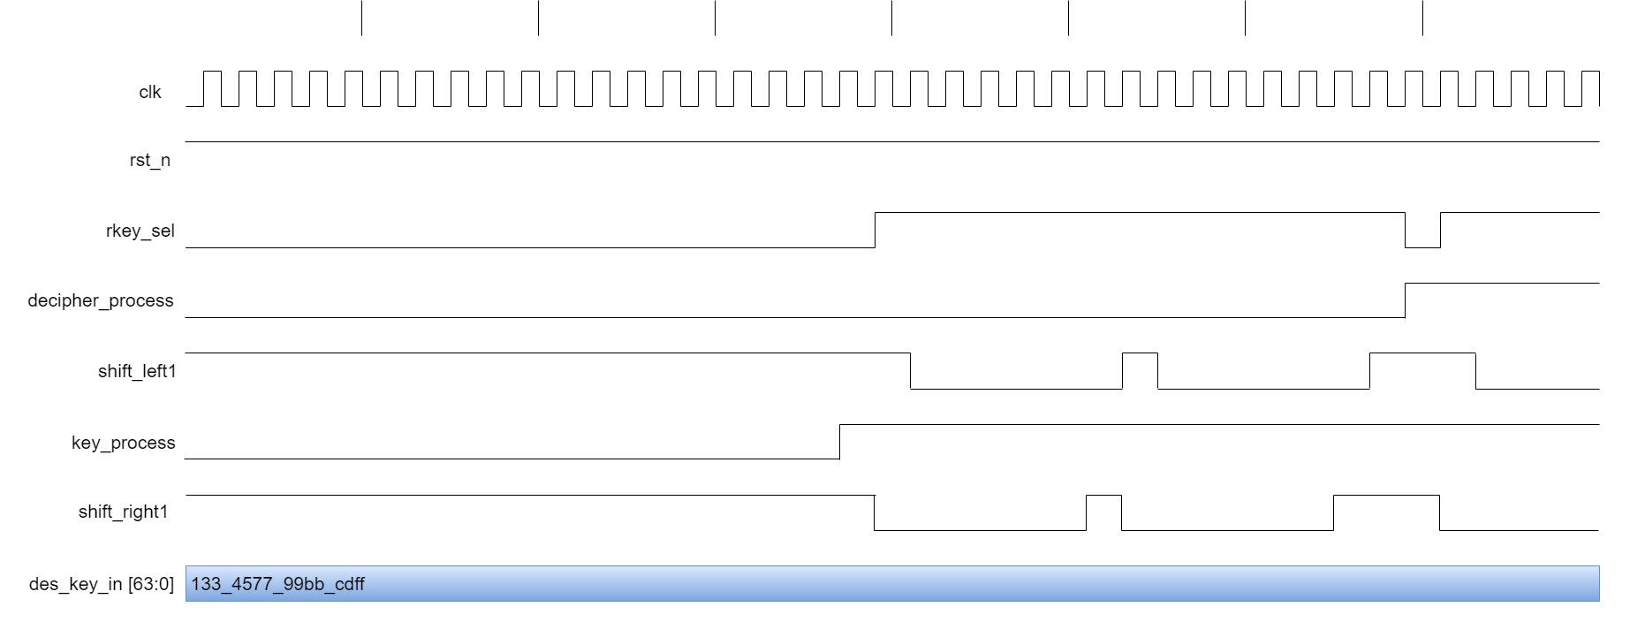
Waveform

Slide 9
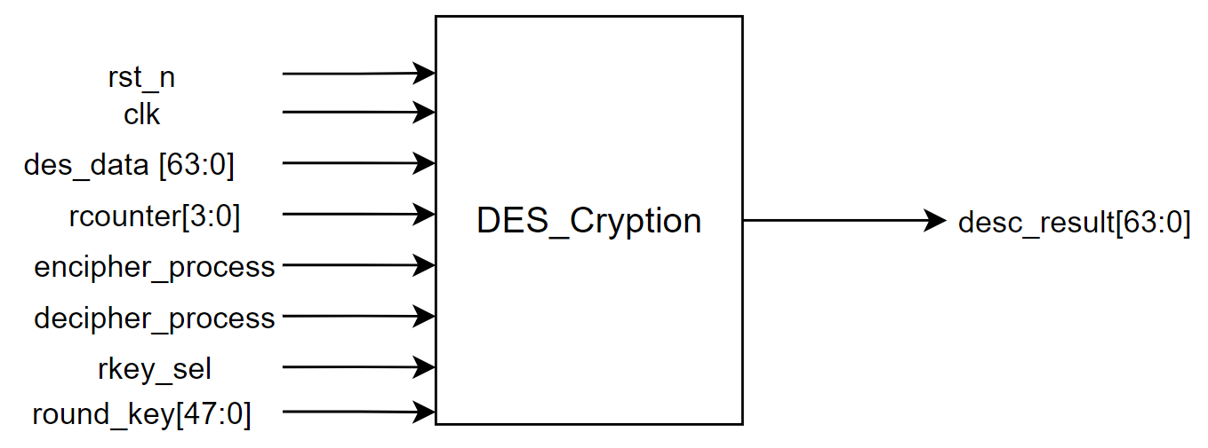
2. DES Data Encryption:
The DES Data Encryption Block performs encryption/ decryption process

Slide 10
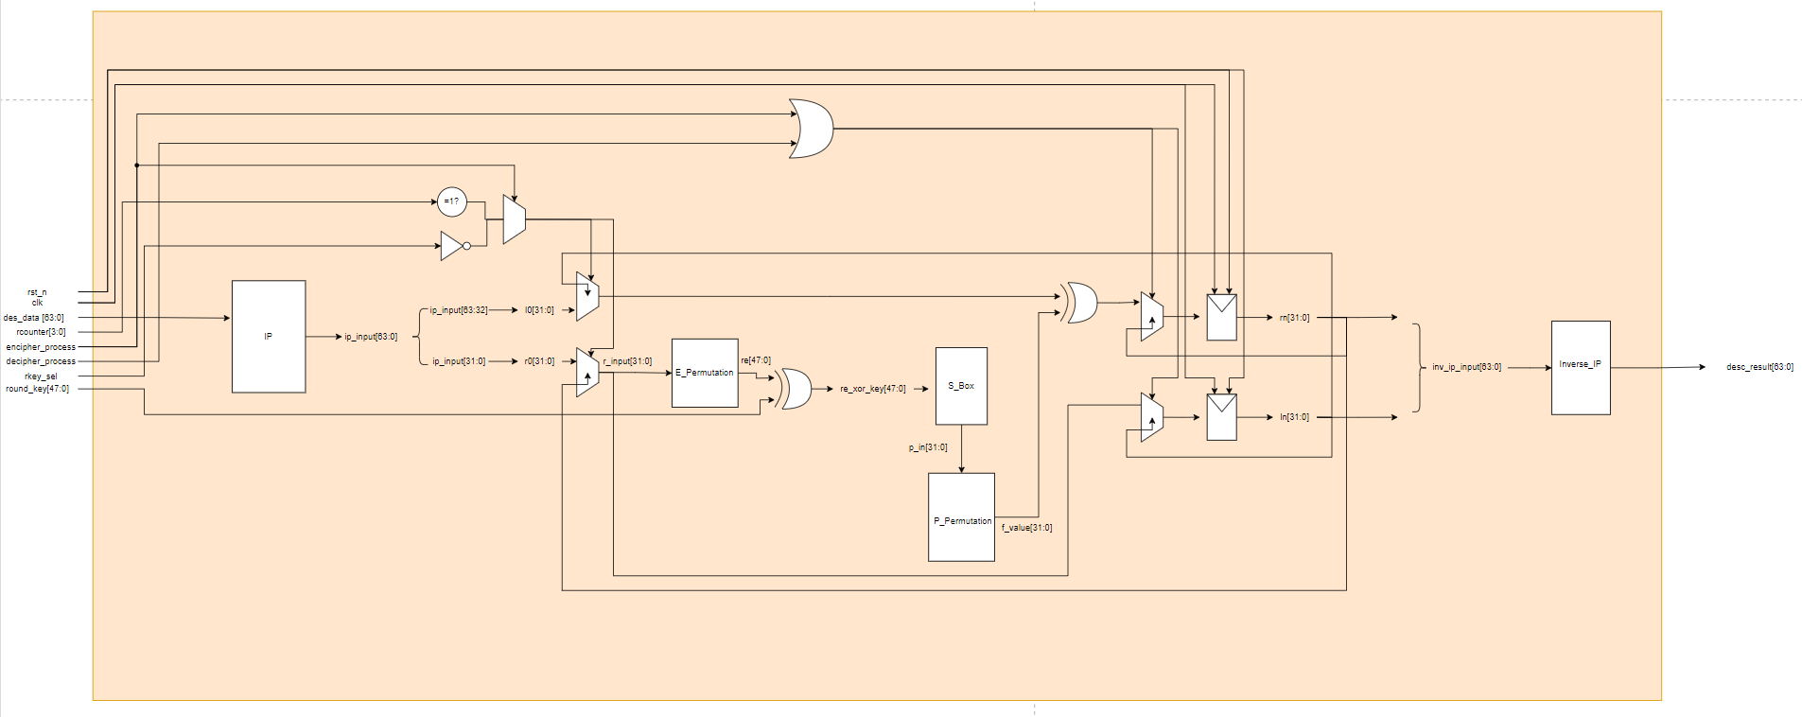
Port | Size | Direction | Description
clk | 1 | input | Clock
rst_n | 1 | input | Asynchronous reset, active low
rcounter | 4 | input | Signal inform when to choose R0/L0
des_data | 64 | input | Data needs encryption
encipher_process | 1 | input | Signal inform when to calculate the next encryption round
decipher_process | 1 | input | Signal inform when to calculate the next decryption round
rkey_sel | 1 | input | Signal inform when to choose R0/L0
round_key | 48 | input | Round key use for data encryption/ decryption processs
desc_result[63:0] | 64 | output | Data has been encrypted/ decrypted

Slide 11
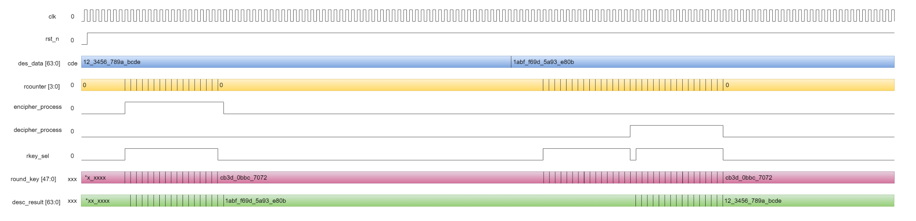
Waveform

Slide 12
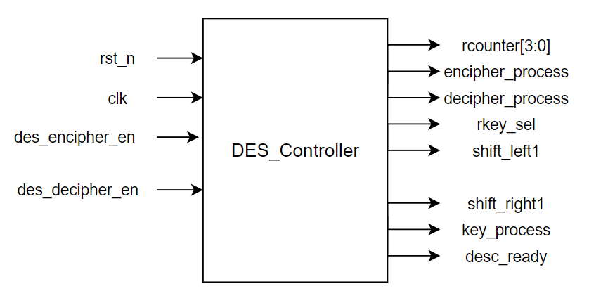
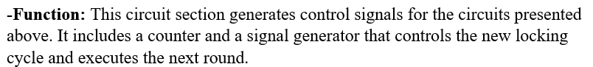
3. DES Controller:

Slide 13
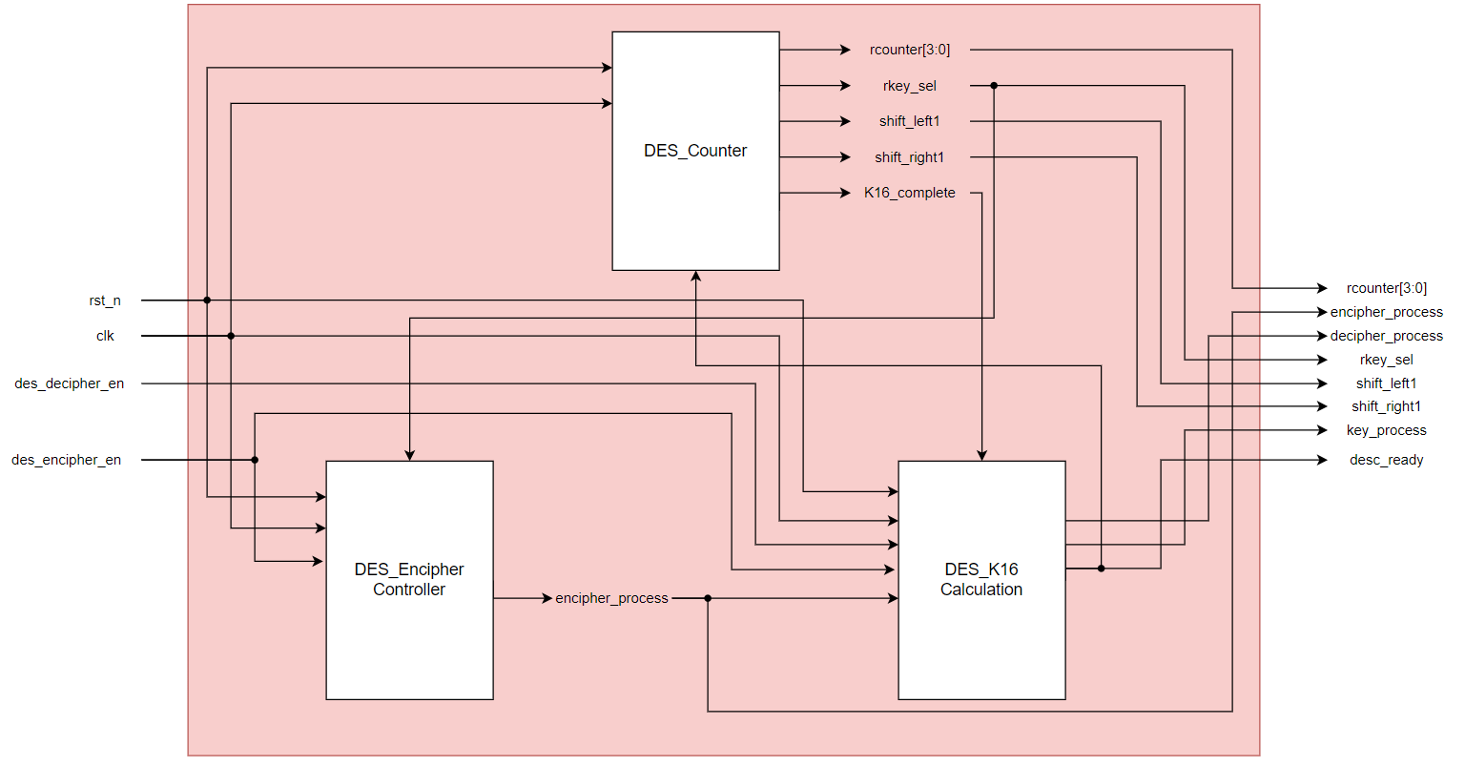
Port | Size | Direction | Description
clk | 1 | input | Clock
rst_n | 1 | input | Asynchronous reset, active low
des_encipher_en | 1 | input | Encryption operate signal, active high
des_decipher_en | 1 | input | Decryption operate signal, active high
shift_left1 | 1 | output | Signal inform when to shift left 1 bit or 2 bits
shift_right1 | 1 | output | Signal inform when to shift right 1 bit or 2 bits
rkey_sel | 1 | output | Signal inform when to use the value C0/D0 or the value Cn/Dn from register.
key_process | 1 | output | Signal inform when to calculate new key round.
rcounter | 4 | output | Counter 4 bit
encipher_process | 1 | output | Signal inform when to calculate the next encryption round
decipher_process | 1 | output | Signal inform when to calculate the next decryption round
desc_ready | 1 | output | Signal inform the cipher core is free or has finished a encryption/ decryption process

Slide 14
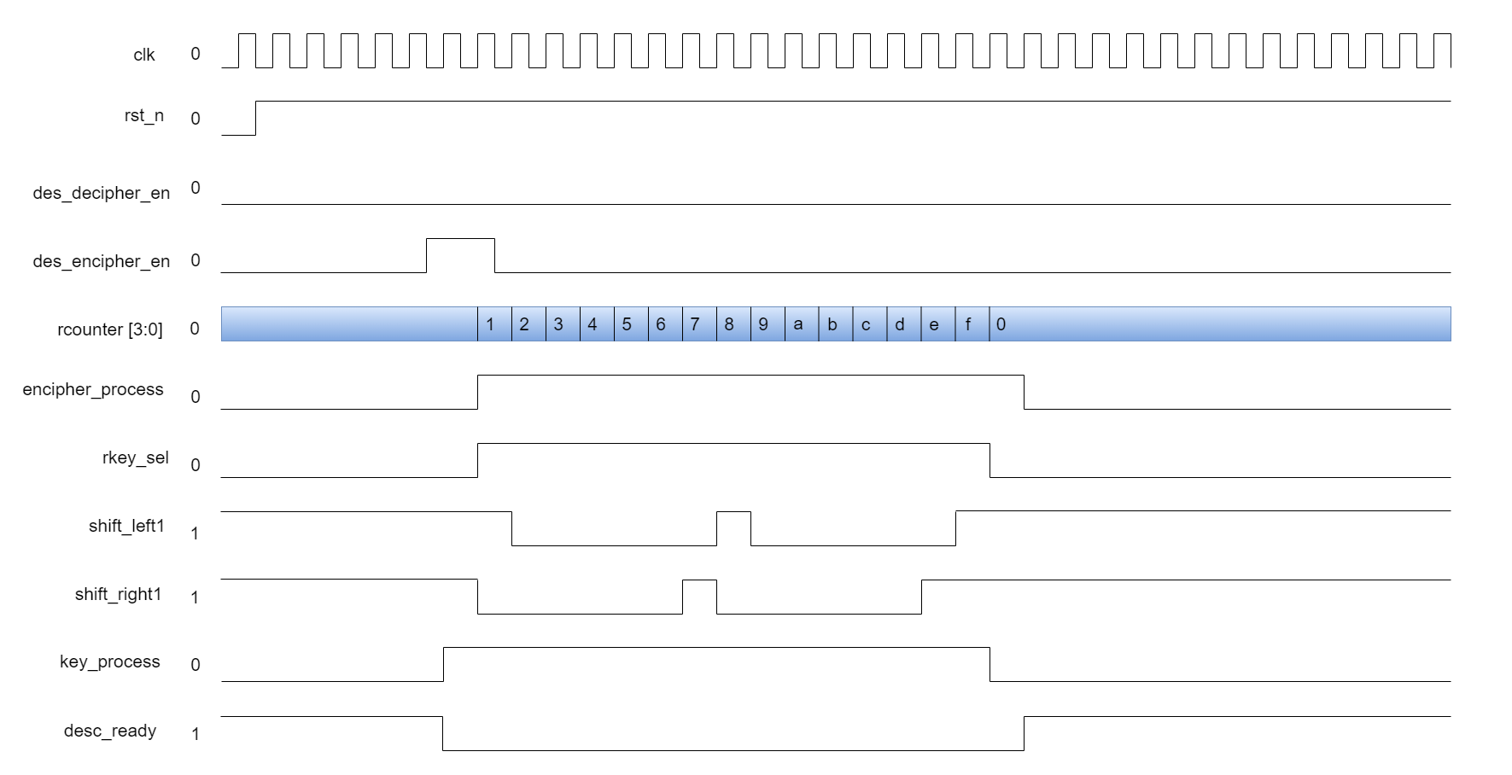
Waveform

Slide 15
II. LOW level Block

Slide 16
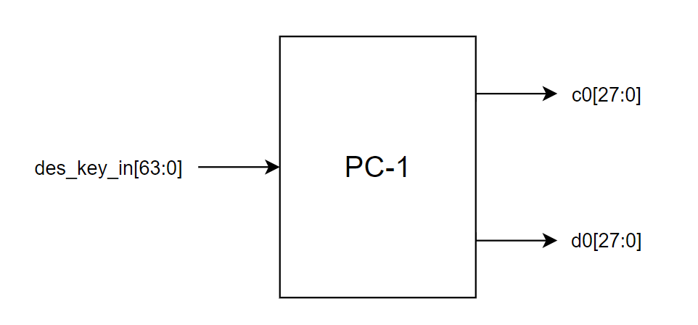
1. PC1 (Permutation Choice 1):
Port | Size | Direction | Description
des_key_in | 64 | input | Key using for encryption
c0 | 28 | output | Bit sequence form 1st to 28th after des_key_in[63:0] permutation.
d0 | 28 | output | Bit sequence form 29th to 56th after des_key_in[63:0] permutation.

Slide 17
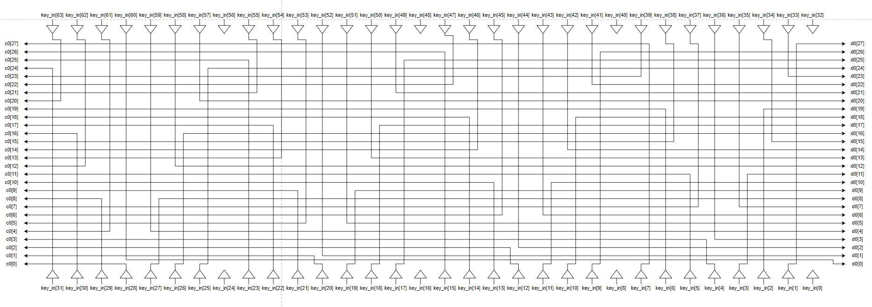
Design

Slide 18
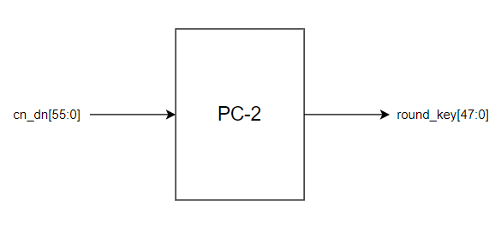
2. PC2 (Permutation Choice 2):
Port | Size | Direction | Description
cn_dn | 56 | input | Bit sequence after left shift
round_key | 48 | output | Round key use for data encryption process

Slide 19
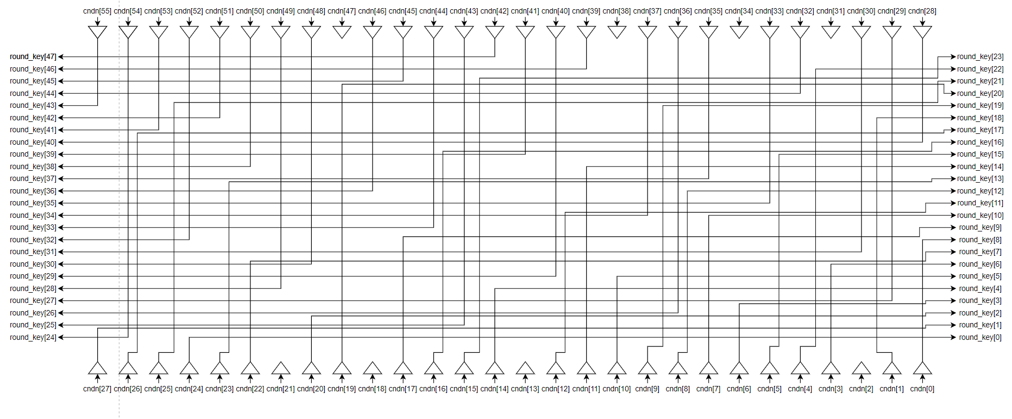
Design

Slide 20
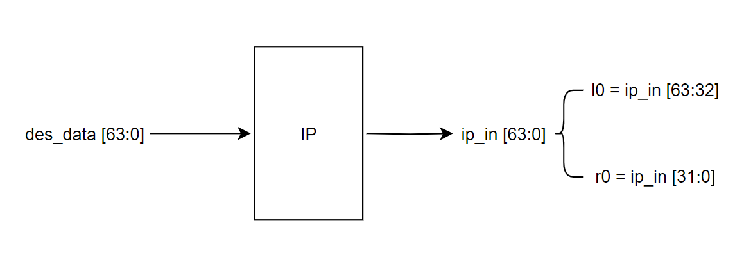
3. IP (Initial Permutation):
Port | Size | Direction | Description
des_data | 64 | input | Data needs encryption
ip_in | 64 | output | Data after permutation. Create the L0/R0 value.

Slide 21
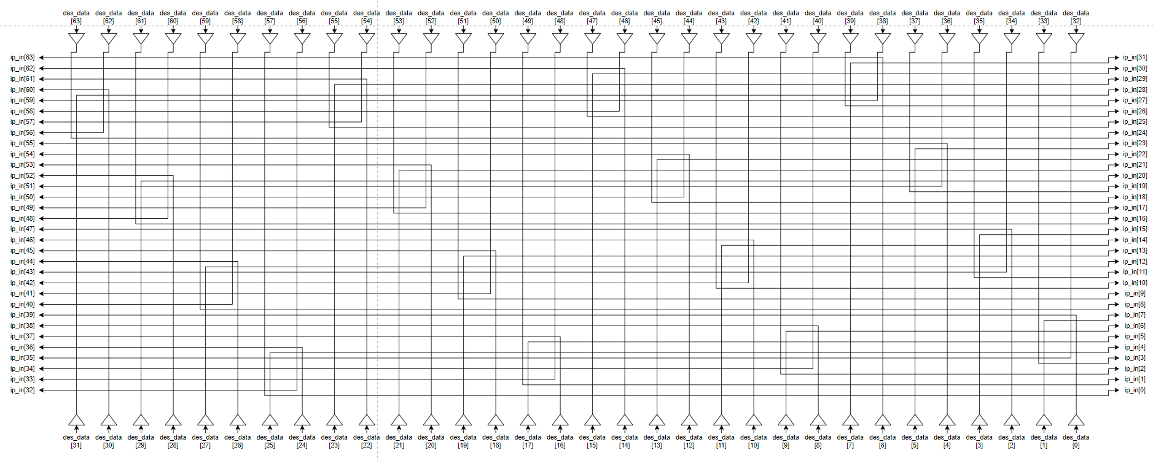
Design

Slide 22
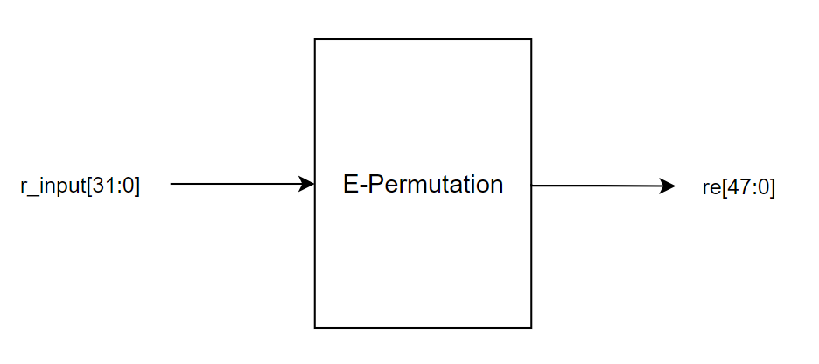
4. E- Permutation:
Port | Size | Direction | Description
r_input | 32 | input | Data use to calculate f(R,K) and Ln/Rn
re | 48 | output | Data after permutation. Input forS-Box

Slide 23
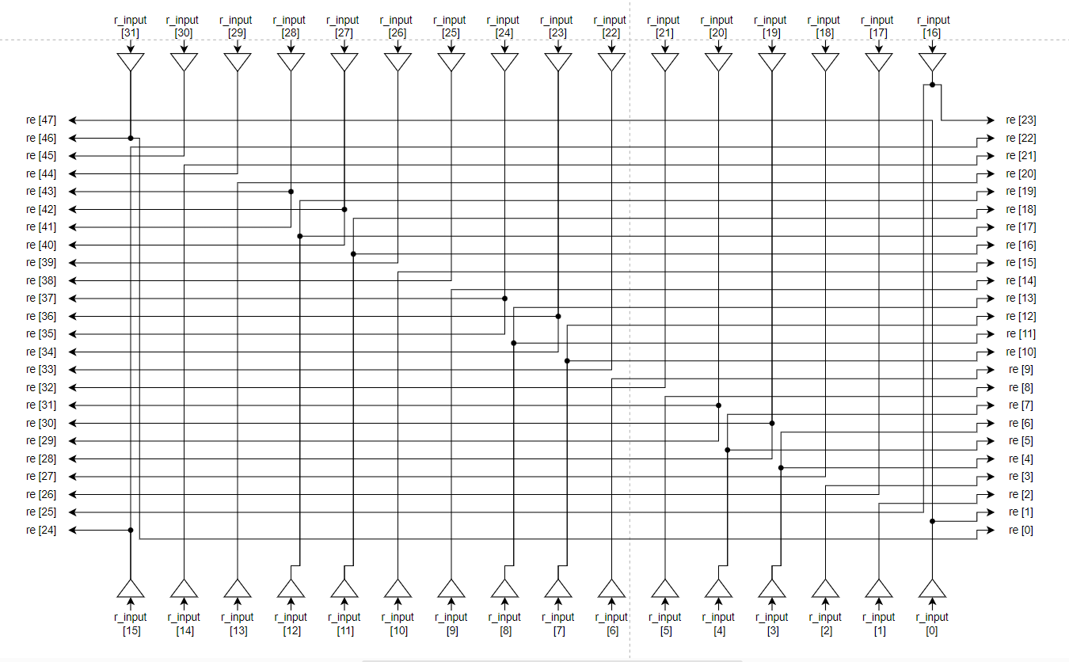
Design

Slide 24
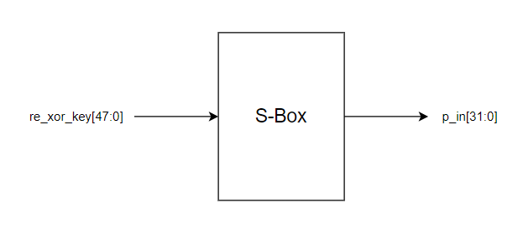
5. S-Box:
Port | Size | Direction | Description
re_xor_key | 48 | input | Data after re[31:0] XOR with key round
p_in | 32 | output | Data after converting from S-box

Slide 25
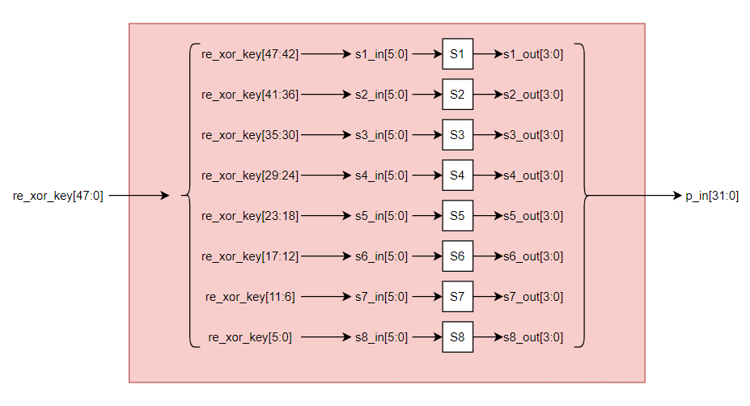
Design

Slide 26
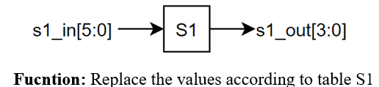
5.1 S1:
Port | Size | Direction | Description
s1_in | 6 | input | Data from 1st to 6th bit of re_xor_key[47:0]
s1_out | 4 | output | Data after converting from S1 table.

Slide 27
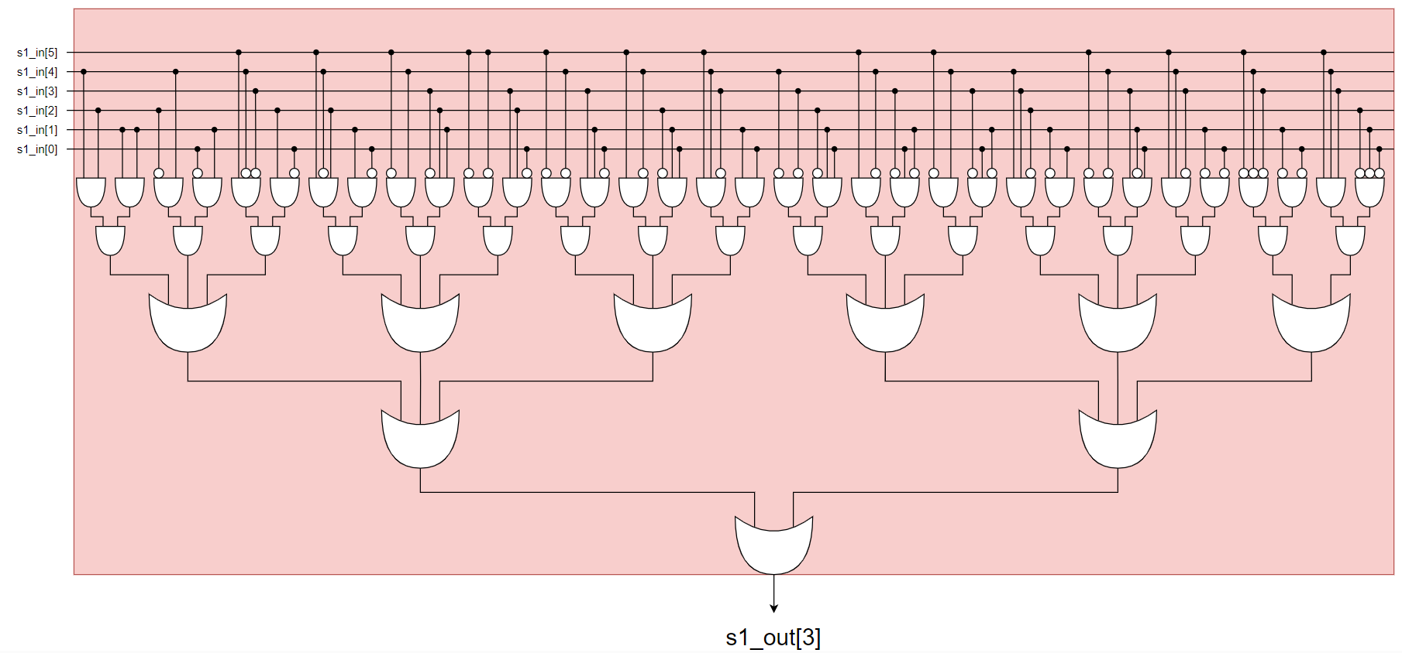
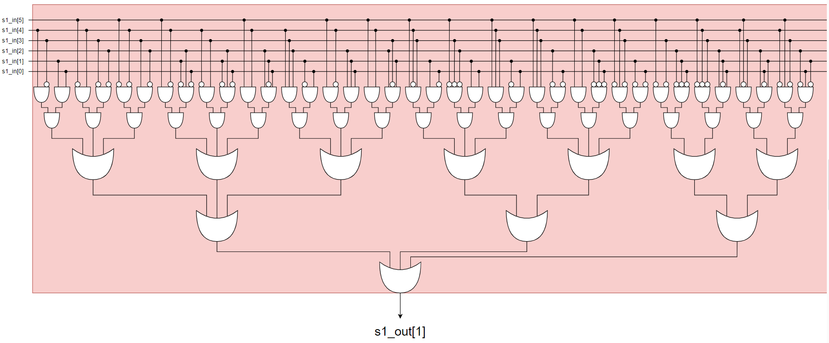
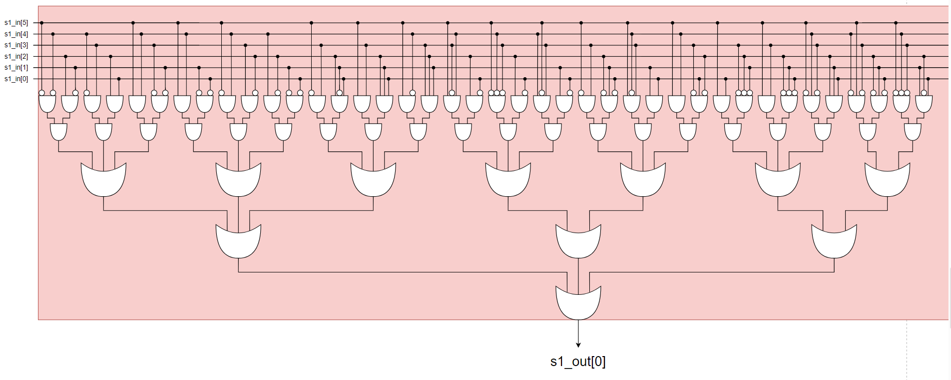
Design

Slide 28
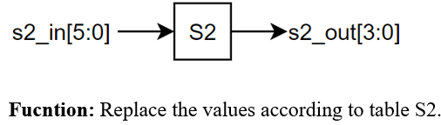
5.2 S2:
Port | Size | Direction | Description
s2_in | 6 | input | Data from 7th to 12nd bit of re_xor_key[47:0]
s2_out | 4 | output | Data after converting from S2 table.

Slide 29
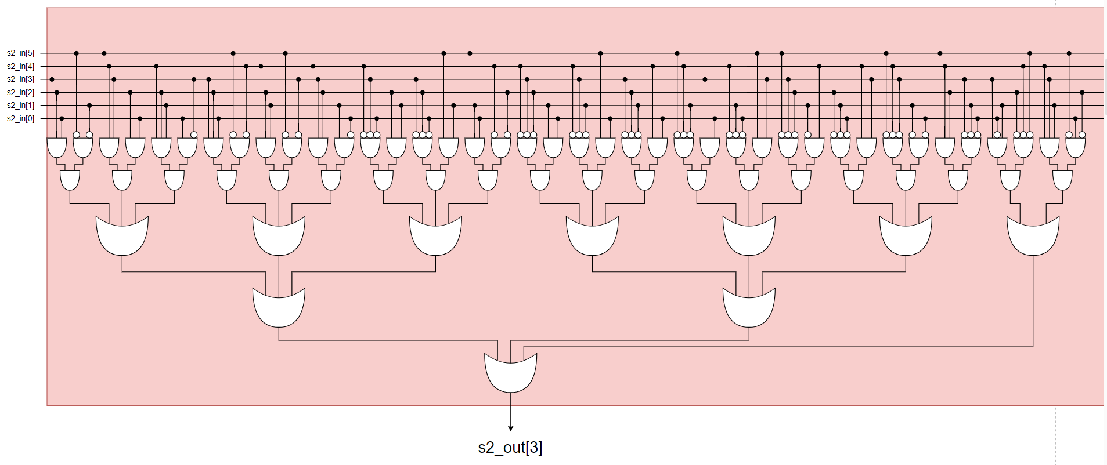
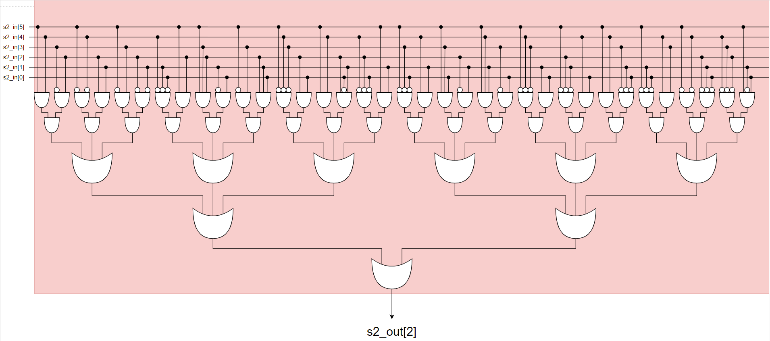
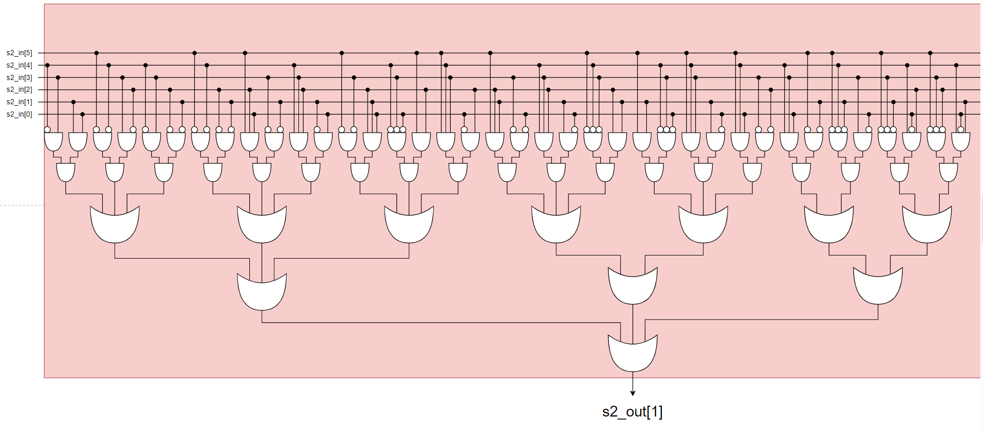
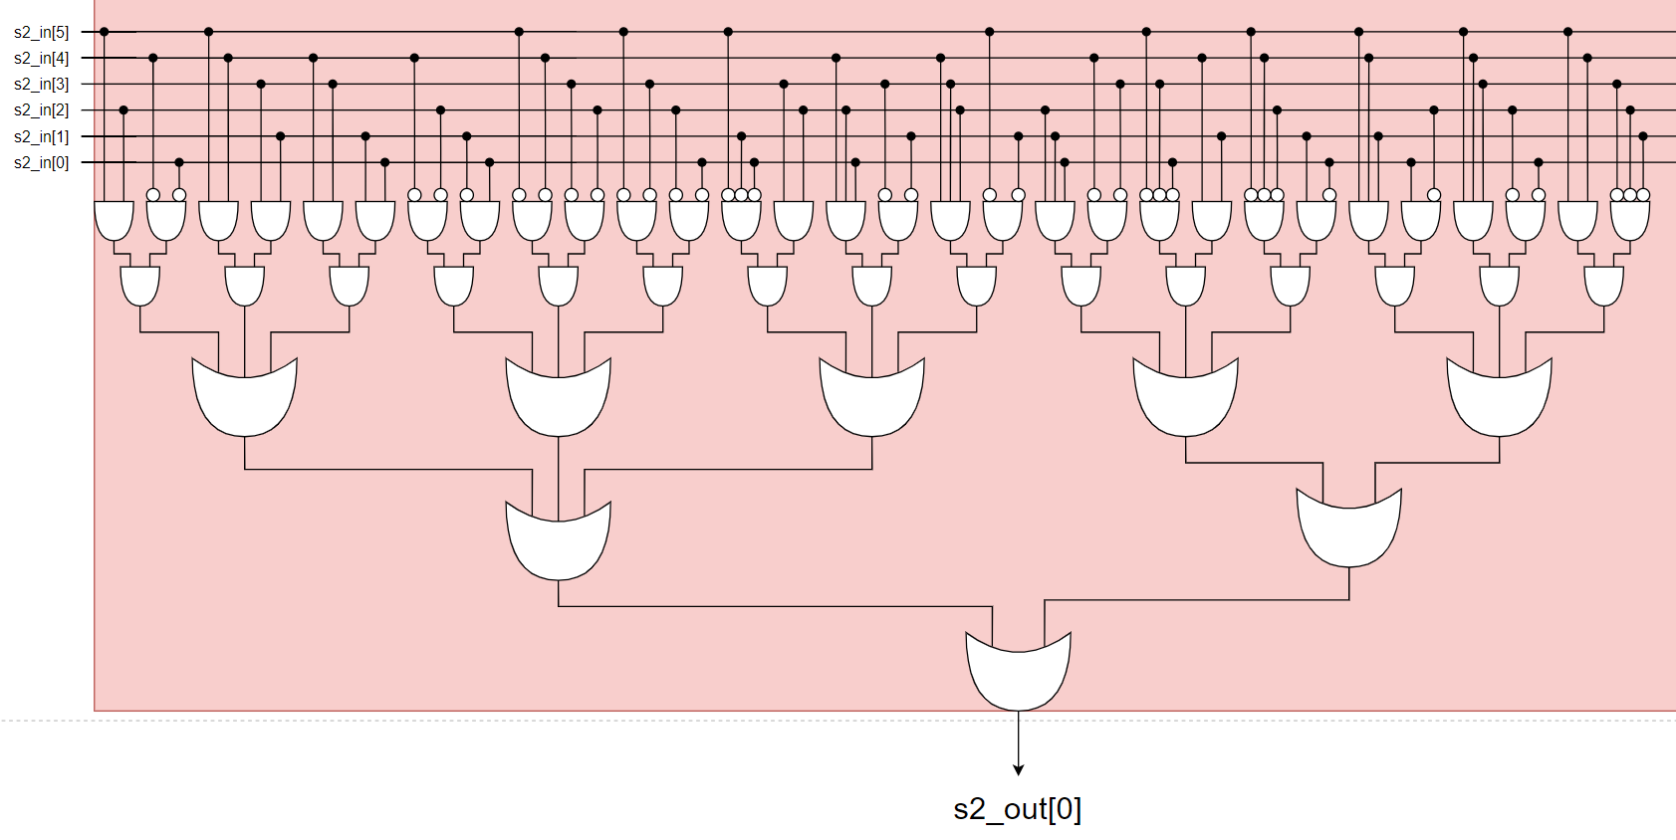
Design

Slide 30
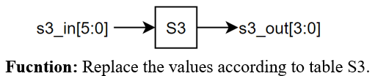
5.3 S3:
Port | Size | Direction | Description
s3_in | 6 | input | Data from 13rd to 18th bit of re_xor_key[47:0]
s3_out | 4 | output | Data after converting from S3 table.

Slide 31
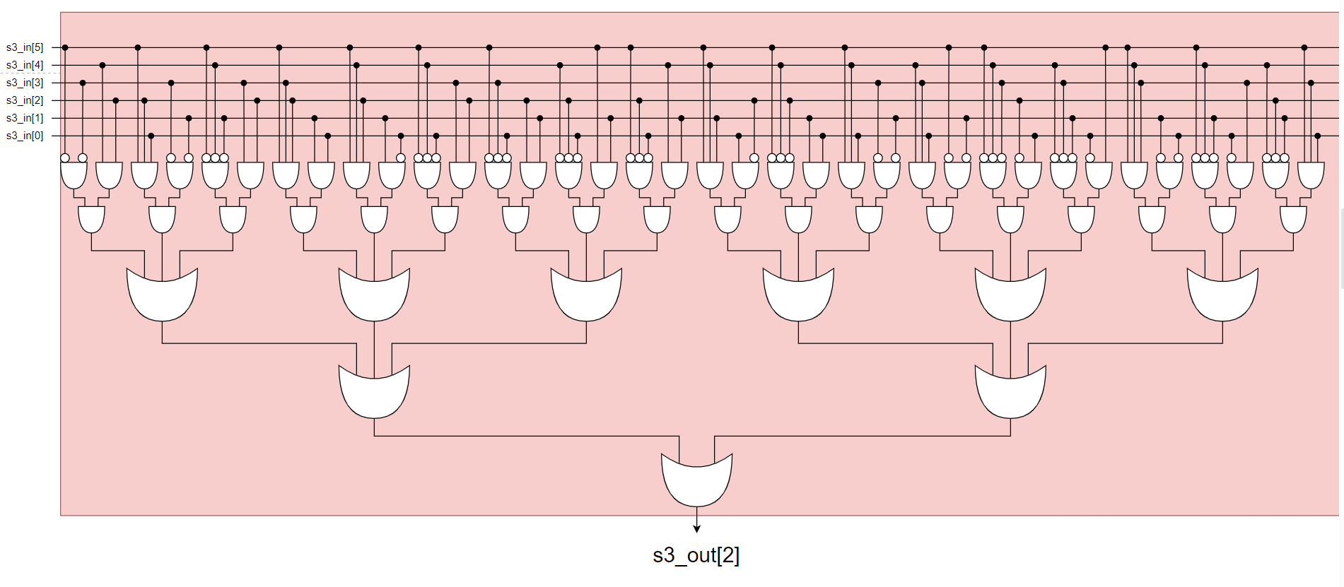
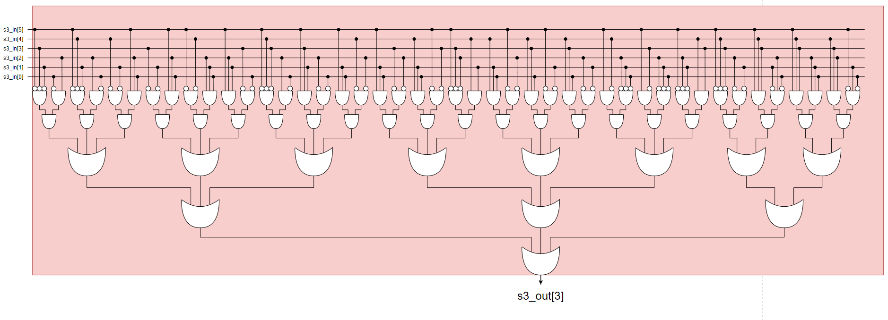
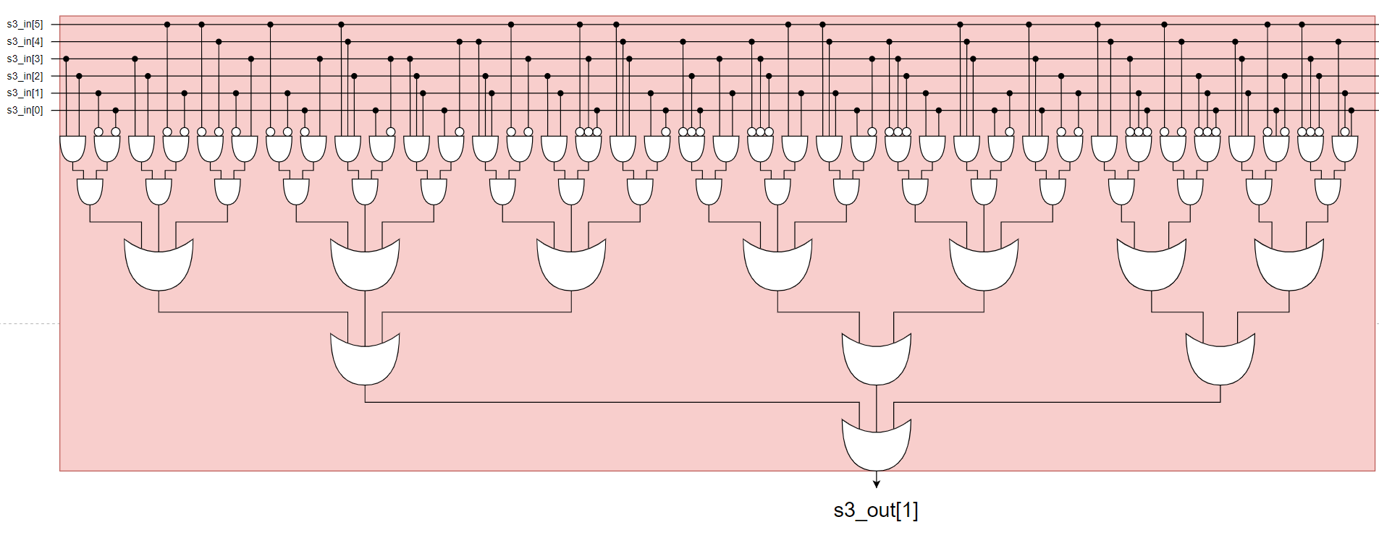
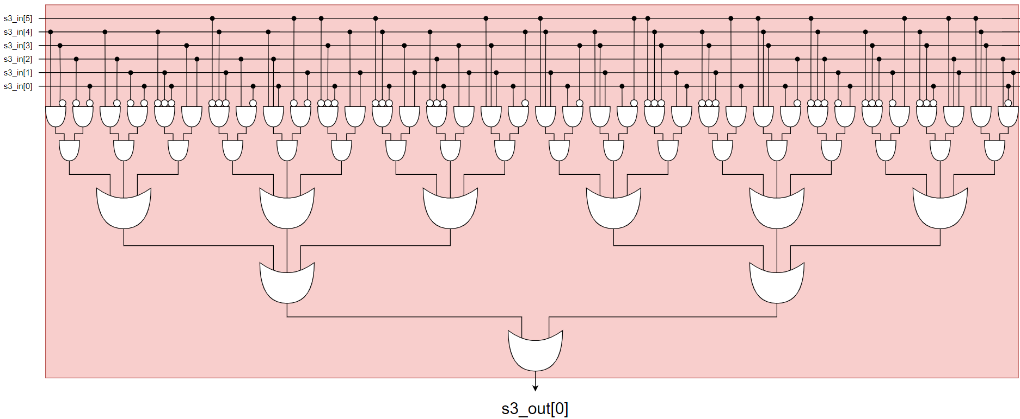
Design

Slide 32
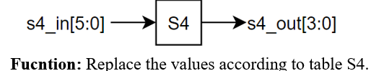
5.4 S4:
Port | Size | Direction | Description
s4_in | 6 | input | Data from 19th to 24th bit of re_xor_key[47:0]
s4_out | 4 | output | Data after converting from S4 table.

Slide 33
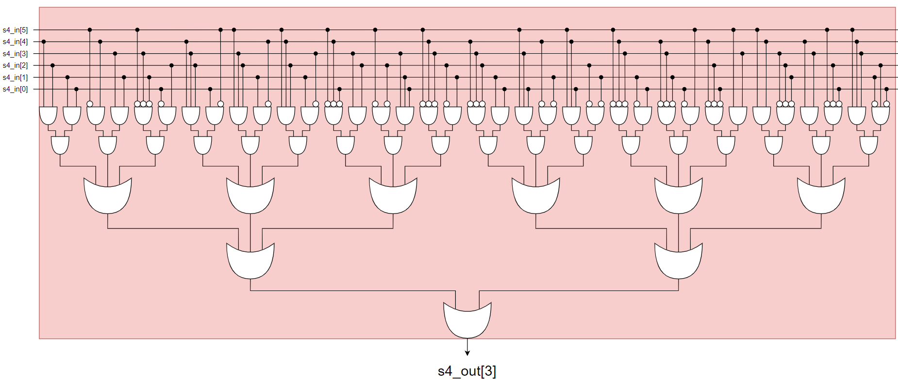
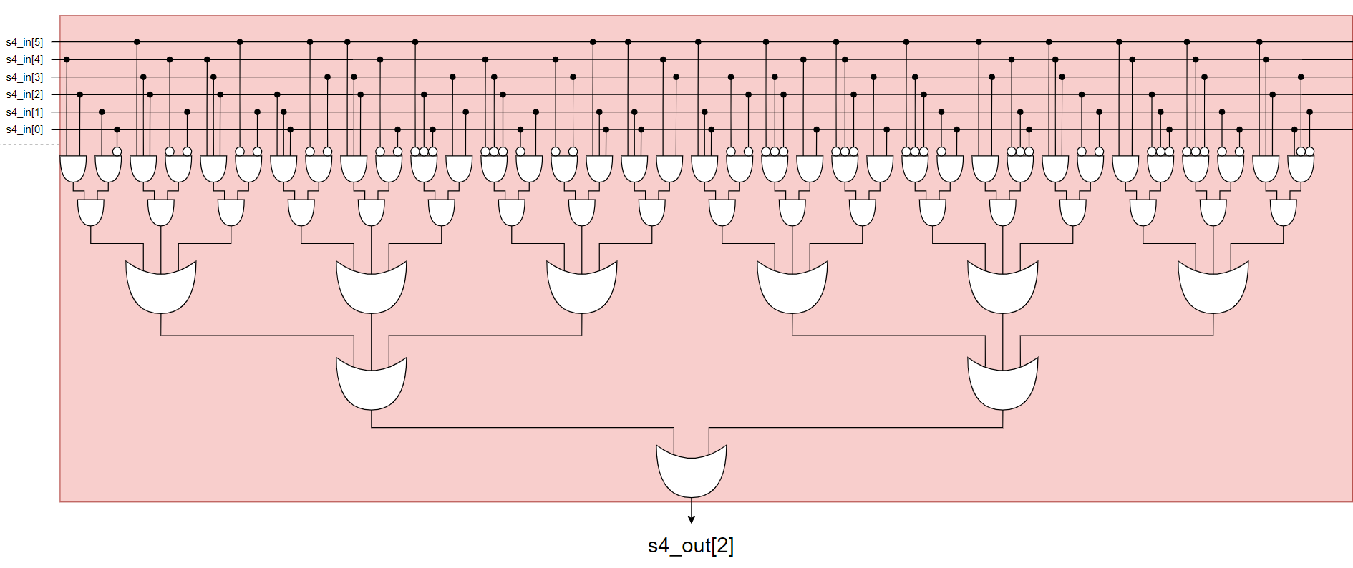
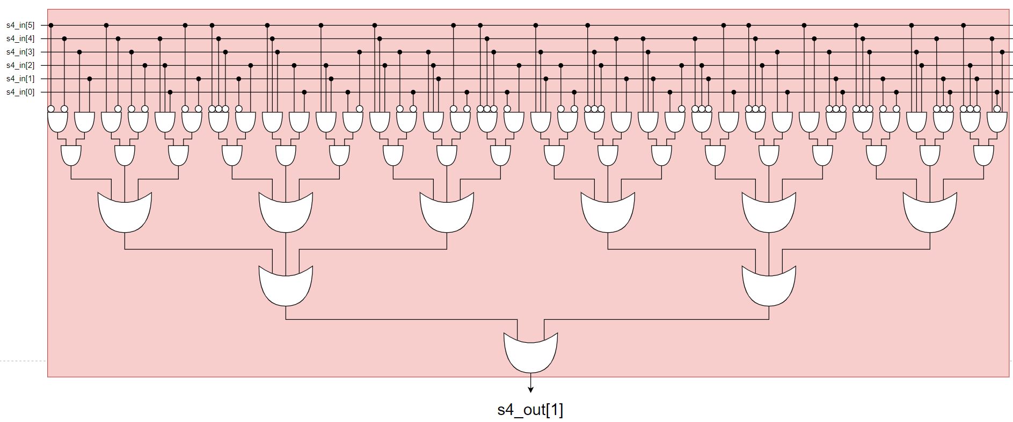
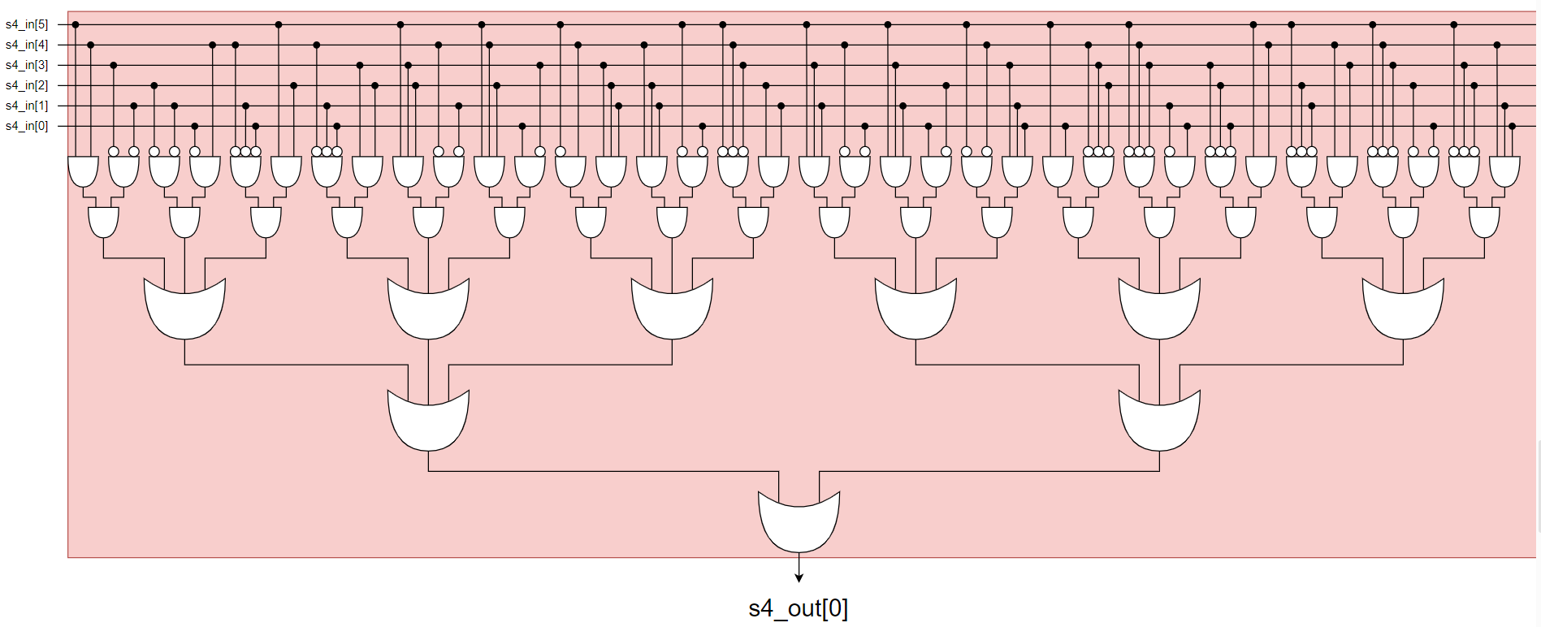
Design

Slide 34
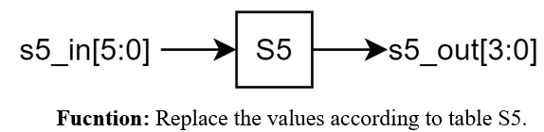
5.5 S5:
Port | Size | Direction | Description
s5_in | 6 | input | Data from 25rd to 30th bit of re_xor_key[47:0]
s5_out | 4 | output | Data after converting from S5 table.

Slide 35
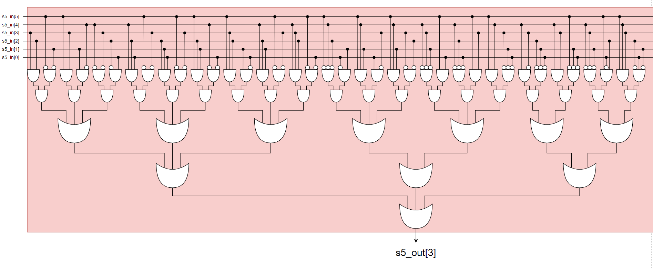
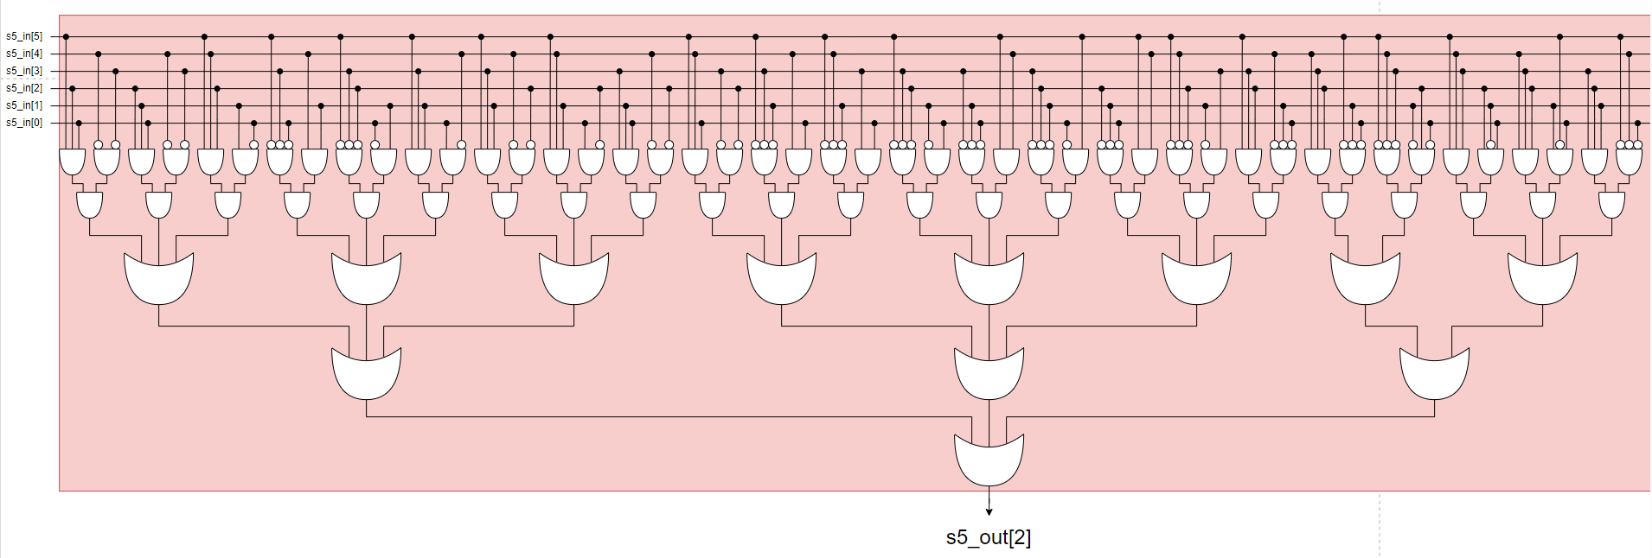
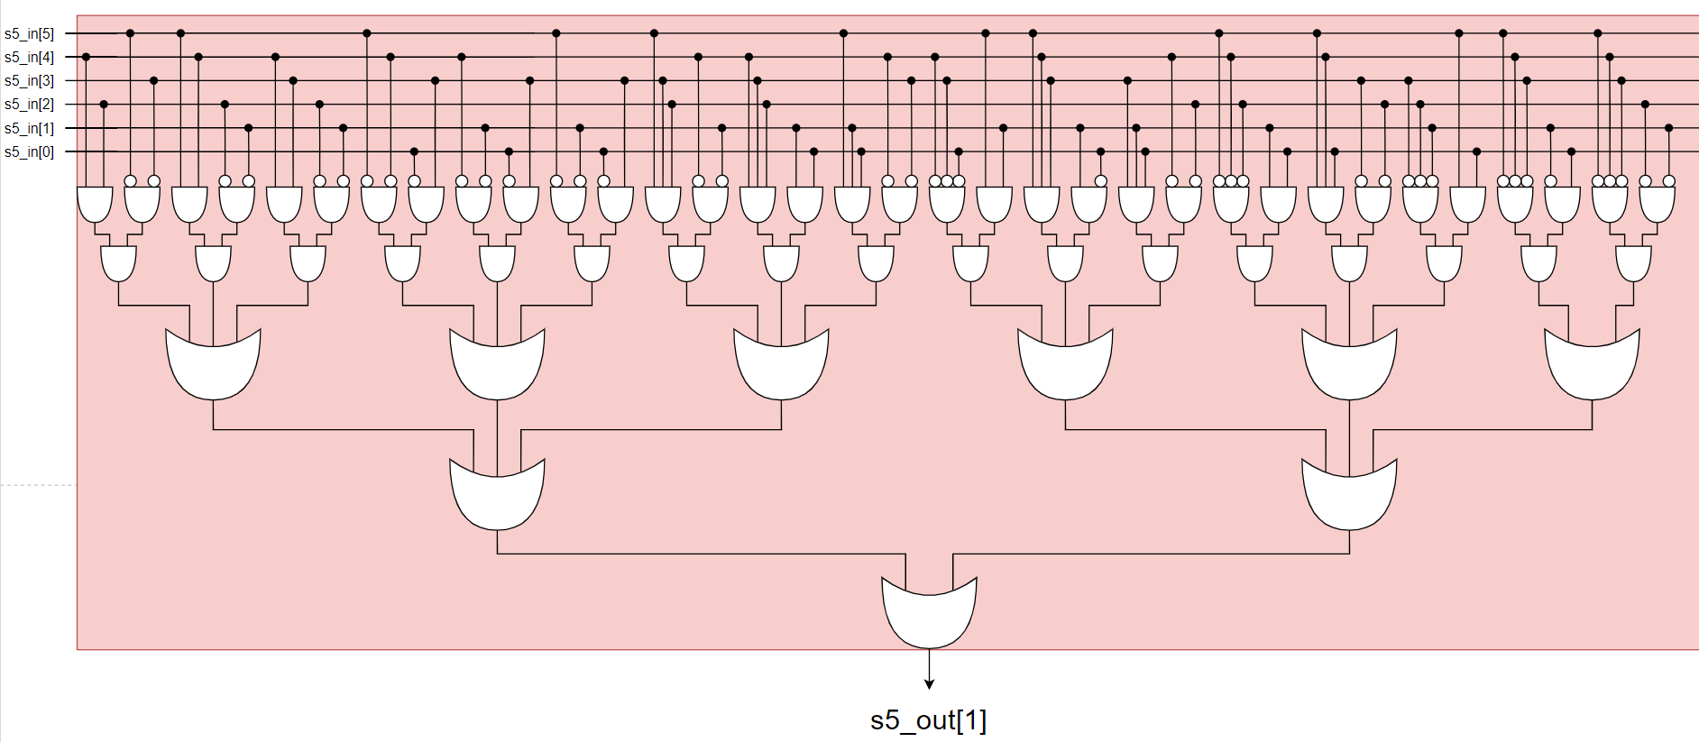
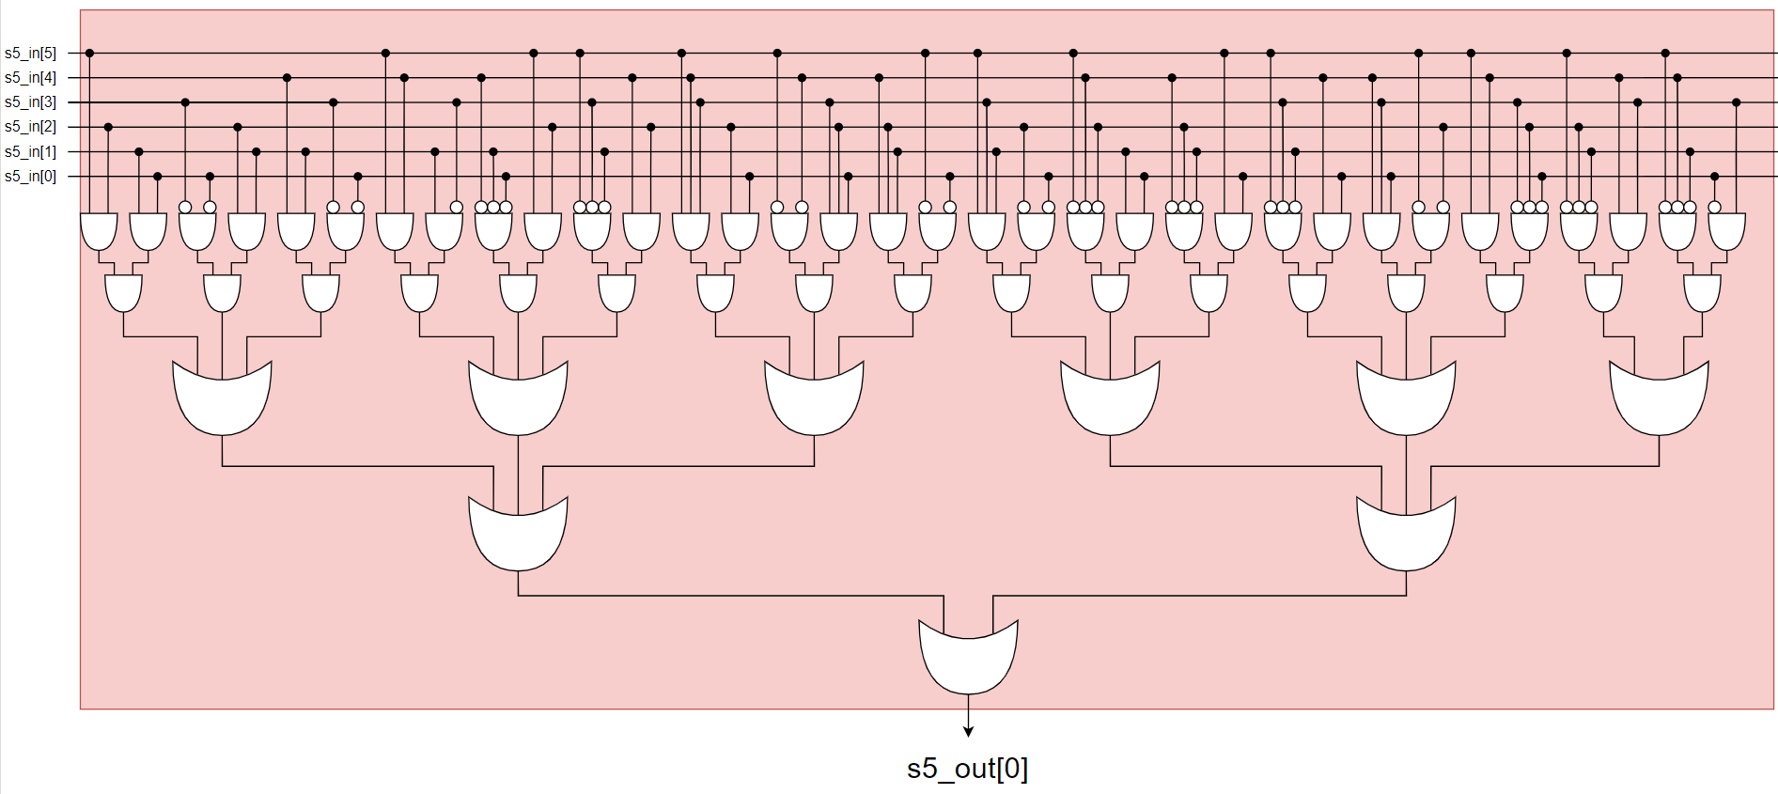
Design

Slide 36
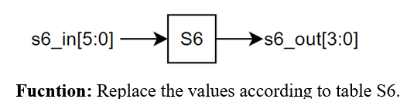
5.6 S6:
Port | Size | Direction | Description
s6_in | 6 | input | Data from 31st to 36th bit of re_xor_key[47:0]
s6_out | 4 | output | Data after converting from S6 table.

Slide 37
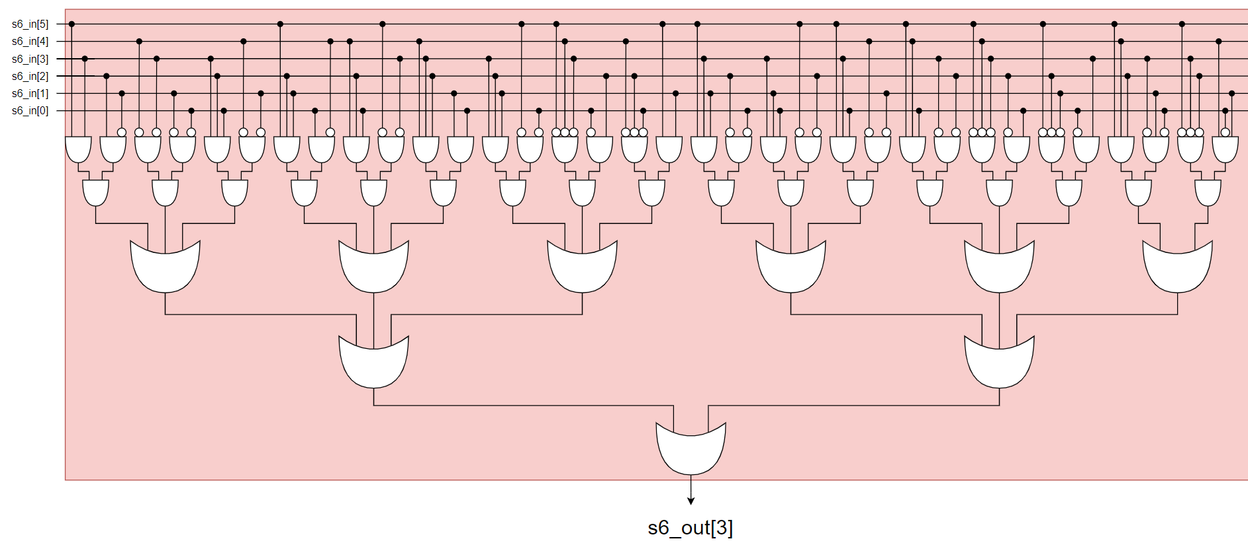



Design

Slide 38

5.7 S7:
Port | Size | Direction | Description
s7_in | 6 | input | Data from 37th to 42nd bit of re_xor_key[47:0]
s7_out | 4 | output | Data after converting from S7 table.

Slide 39




Design

Slide 40

5.8 S8:
Port | Size | Direction | Description
s8_in | 6 | input | Data from 43th to 48nd bit of re_xor_key[47:0]
s8_out | 4 | output | Data after converting from S8 table.

Slide 41




Design

Slide 42

6. P-Permutation:
Port | Size | Direction | Description
p_in | 32 | input | Data after converting from S-box.
f_value | 32 | output | The value of f(R,K)

Slide 43

Design

Slide 44

7. Inverse IP (Inverse Initial Permutation):
-Function: Permute the Rn/Ln string to generate the encrypted data.
Port | Size | Direction | Description
inv_p_input | 64 | input | The value is composed of two values, Rn and Ln.
cipher_text | 64 | output | The value of each encoding loop and the encoded value if the encoder is in the final loop.

Slide 45

Design

Slide 46

8. DES Counter :
Function: A 4-bit counter is used to determine the number of times the DES core is repeated. At the same time, the value of this counter is used to generate additional control signals
Port | Size | Direction | Description
clk | 1 | input | Clock
rst_n | 1 | input | Reset Asynchronous, active low
key_process | 1 | input | Signal inform when to calculate new key round.
cipher_complete | 1 | output | Signal inform that the cipher has been finished an encryption process
shift_1 | 1 | output | Signal inform when to shift left 1 bit or 2 bits
rkey_sel | 1 | output | Signal inform when to use the value C0/D0 or the value Cn/Dn from register.
cipher_sel | 1 | output | Signal inform when to use the value L0/R0 or the value Ln/Rn from register.
desc_ready | 1 | output | Signal inform the cipher core is free or has finished an encryption process

Slide 47

Design

Slide 48

9. DES Decipher And Key Controller :
Function: The circuit generates a control signal for creating a new loop key and executing the next decryption round
Port | Size | Direction | Description
clk | 1 | input | Clock
rst_n | 1 | input | Reset Asynchronous, active low
des_encipher_en | 1 | input | Encryption start signal, active high
des_decipher_en | 1 | input | Signal inform that the cipher has been finished an encryption process
k16_complete | 1 | input | Signal inform when to calculate new key round.
encipher_process | 1 | input | Signal inform when to calculate the next encryption round
decipher_process | 1 | output | Signal inform when to calculate the next decryption round
key_process | 1 | output | Signal inform when to calculate new key round.
desc_ready | 1 | output | Signal inform the cipher core is free or has finished a encryption/ decryption process

Slide 49

Design

Slide 50

10. DES Encipher Controller :
Function: The circuit generates a control signal for creating a new loop key and executing the next decryption round
Port | Size | Direction | Description
clk | 1 | input | Clock
rst_n | 1 | input | Reset Asynchronous, active low
des_encipher_en | 1 | input | Encryption start signal, active high
rkey_sel | 1 | output | Signal inform when to use the value C0/D0 or the value Cn/Dn from register.
encipher_process | 1 | output | Signal inform when to calculate the next encryption round .

Slide 51

Design

